Slide 1
IMAGE SEGMENTATION
Presented By :
Alankrita Mingwal (190970101012)
Aman Kala (190970101014)
Deep Chauhan (190970101020)
Vijay Singh Bisht (190970101051)

Slide 2
ABSTRACT
Image Segmentation is the process by which a digital image is partitioned into various subgroups (of pixels) called Image Objects. The goal of segmentation is to simplify and/or change the representation of an image into something that is more meaningful and easier to analyze.Image segmentation is typically used to locate objects and boundaries in images.

Slide 3
WHAT IS IMAGE SEGMENTATION?
Image Segmentation is the process by which a digital image is partitioned into various subgroups (of pixels) called Image Objects, which can reduce the complexity of the image, and thus analysing the image becomes simpler.
The image segmentation algorithms try to collect similar pixels together and separate out dissimilar pixels. This is done by following two approaches based on the image properties:
i) Similarity Detection (Region Approach)
ii) Discontinuity Detection (Boundary Approach)

Slide 4
Applications of Image Segmentation:
There are countless applications that can be implemented with the help of image segmentation.Our group will try to implement some of these applications of image segmentation.
Improved Quality of MRI/Medical images for better detection of diseases and problems
Lane detection used for vehicle navigation, lateral control, collision prevention, or lane departure warning system.
Generic object segmenting images can help to improve robot vision
Image segmentation can also be applied to satellite images in order to get better object detection

Slide 5
Generic Object Segmentation
Object detection, one of the most fundamental and challenging problems in computer vision, seeks to locate object instances from a large number of predefined categories in natural images.
The main use of generic object detection is in the field of computer vision . Computer vision is an interdisciplinary scientific field that deals with how computers can gain high-level understanding from digital images or videos. From the perspective of engineering, it seeks to understand and automate tasks that the human visual system can do.

Slide 6
Methodology:
Generic Object Segmentation: The K-means algorithm is an iterative technique that is used to partition an image into K clusters.The basic algorithm is 1.Pick K cluster centers, either randomly or based on some heuristic method. 2.Assign each pixel in the image to the cluster that minimizes the distance between the pixel and the cluster center 3.Re-compute the cluster centers by averaging all of the pixels in the cluster 4.Repeat steps 2 and 3 until convergence is attained (i.e. no pixels change clusters)
In this case, distance is the squared or absolute difference between a pixel and a cluster center. This algorithm is guaranteed to converge, but it may not return the optimal solution. The quality of the solution depends on the initial set of clusters and the value of K.

Slide 7
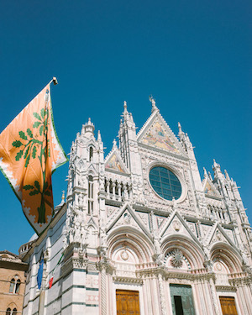
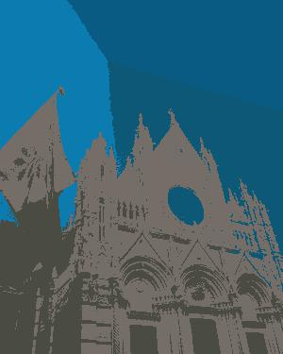
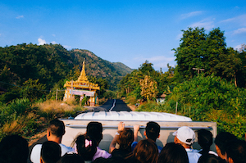
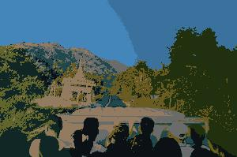
Results:
a)k=5 in this case b)k=8 in this case

Slide 8
Medical Image Enhancement
Medical imaging is the process of producing visible images of inner structures of the body for scientific and medicinal study and treatment as well as a visible view of the function of interior tissues. This process pursues the disorder identification and management.
This process includes both organic and radiological imaging which used electromagnetic energies (X-rays and gamma), sonography, magnetic, scopes, and thermal and isotope imaging. There are many other technologies used to record information about the location and function of the body. Those techniques have many limitations compared to those modulates which produce images.
The goal of my program is to use image segmentation on medical MRI images to improve the contrast and segment the different parts of the image to for better detection of tumors ,diseases and anomalies.

Slide 9
Methodology:
This program uses K-NN algorithm in order to segment the MRI scans
The steps Involved in my algorithm are:
Main Algorithm working:
1.Choosing the number of Clusters(n) and using k-means to make the classes
2.kmeans centers points for centroid.
3.Assigning each Data point or as we say each pixel value to the above centroid using KNN that further gives us clusters.
4.In our case 41 was passed as the number of neighbors(Odd number to break tie)
5.On the last step we just do the concatenation of original and segmented image

Slide 10

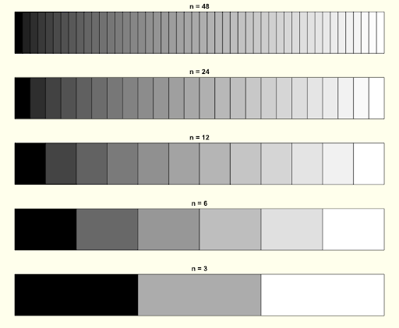
Conversion of Grayscale to New Scale(Depending on value of n) for Segmentation
Notes:
I used BGR scale for better contrast.

Slide 11
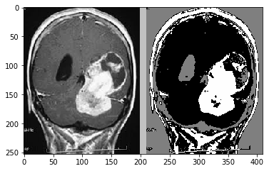
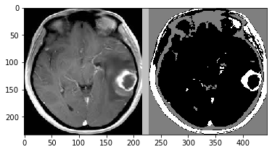
Results:
Example 1:Left hand side is the input MRI scan and the Right hand side is the output segmented MRI scan
Example 2:Left hand side is the input MRI scan of a tumor in the brain and the Right hand side is the output segmented MRI scan

Slide 12
Lane Detection
Lane detection is the process of locating lane markers on the road and presenting these locations to an intelligent system. The applications of a lane detecting system could be as simple as pointing out lane locations to the driver on an external display, to more complicated tasks such as predicting a lane change in the immediate future in order to avoid potential collisions with other vehicles. Some of the interfaces used to detect lanes include cameras, laser range images, LIDAR and GPS devices. Our method relies on the use of Dash cam cameras to accomplish the task.

Slide 13
Road segmentation using Satellite images:
Semantic segmentation is the process of classifying each pixel of an image into distinct classes using deep learning. This aids in identifying regions in an image where certain objects reside.
We can identify and segment roads in aerial imagery. Detecting roads can be an important factor in predicting further development of cities and also segmentation of roads is important to map-based applications and is used for finding distances or shortest routes between two places.

Slide 14
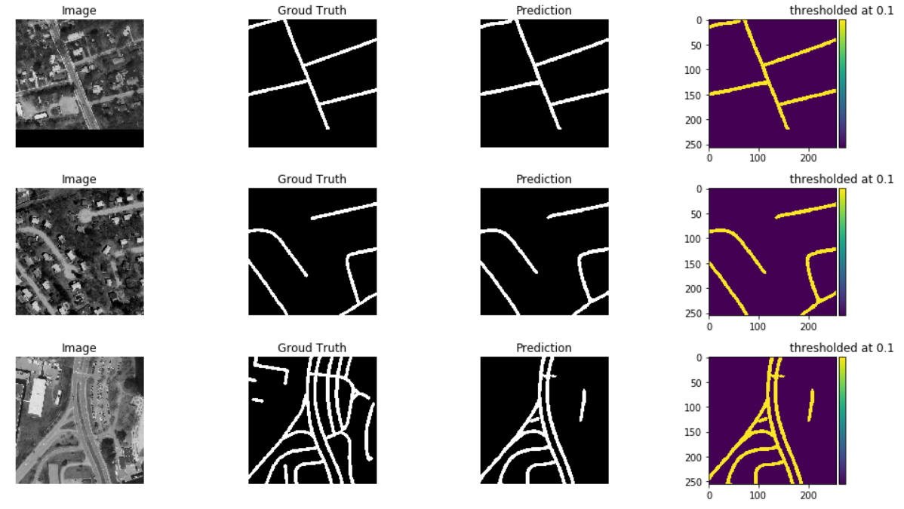
Results:

Slide 15
THANK YOU

